Slide 1
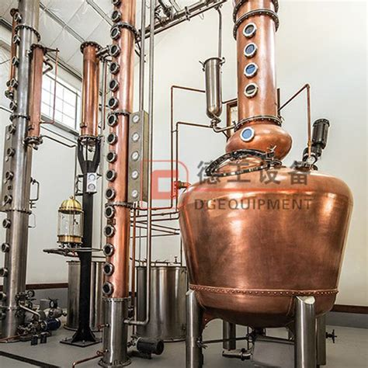
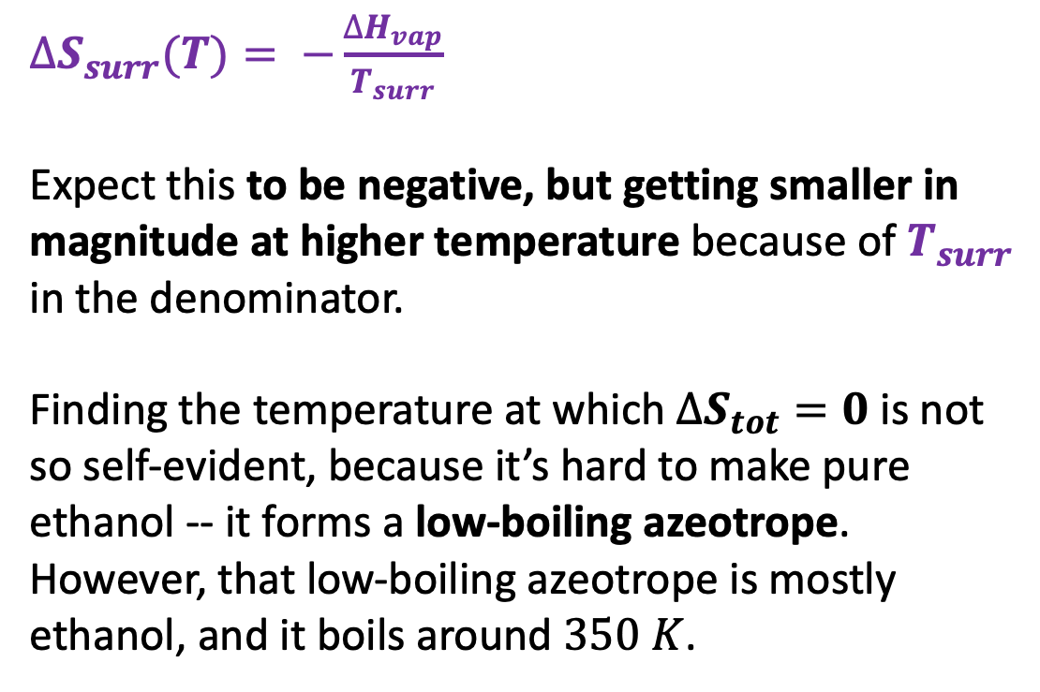
A caveat about what we said about the boiling temperature of ethanol
$$∆S_{tot}={∆S}_{vap}\left(T\right)+∆S_{surr}$$
$∆S_{surr}(T)= −\frac{∆H_{vap}}{T_{surr}}$
Expect this to be negative, but getting smaller in magnitude at higher temperature because of $T_{surr}$ in the denominator.
Finding the temperature at which $∆S_{tot}=0$ is not so self-evident, because it’s hard to make pure ethanol -- it forms a low-boiling azeotrope. However, that low-boiling azeotrope is mostly ethanol, and it boils around $350 K$.

Slide 2
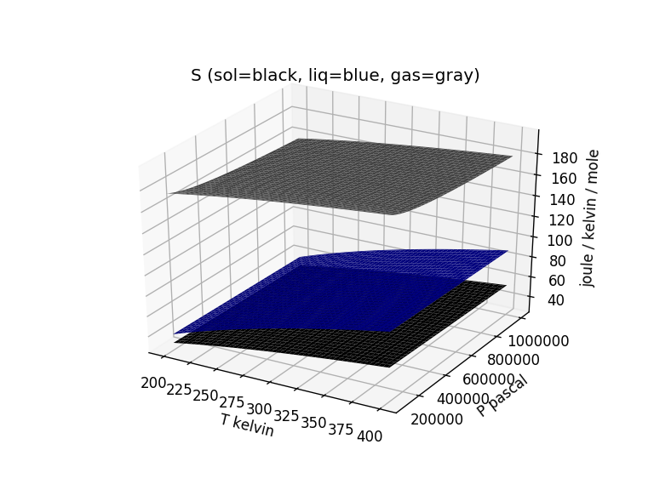
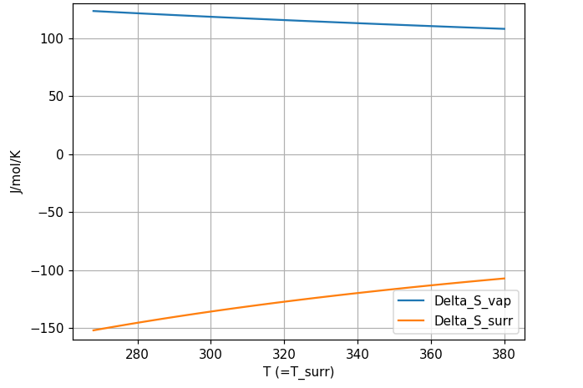



Two parts of the entropy that determine the boiling temperature (of water)
$$∆S_{vap}$$
$$∆S_{vap}$$
$$∆S_{surr}$$

Slide 3
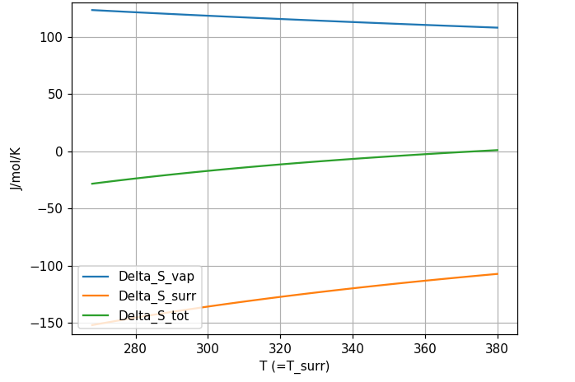
Two parts of the entropy that determine the boiling temperature (of water)
$$∆S_{vap}$$
$$∆S_{vap}$$
$$∆S_{surr}$$

Slide 4
Two parts of the entropy that determine the boiling temperature (of water)
$$∆S_{vap}$$
$$∆S_{vap}$$
$$∆S_{surr}$$

